Slide 1



Pneumatic System Integration in Supersonic Flow
NASA Space Grant Undergraduate Research Symposium
April 20, 2024
Rachel Rhomberg
Special Acknowledgments:
The University Consortium for Applied Hypersonics
Arizona Research Center for Hypersonics
Mentor: Dr. James Threadgill
Department of Aerospace and Mechanical Engineering

Slide 2
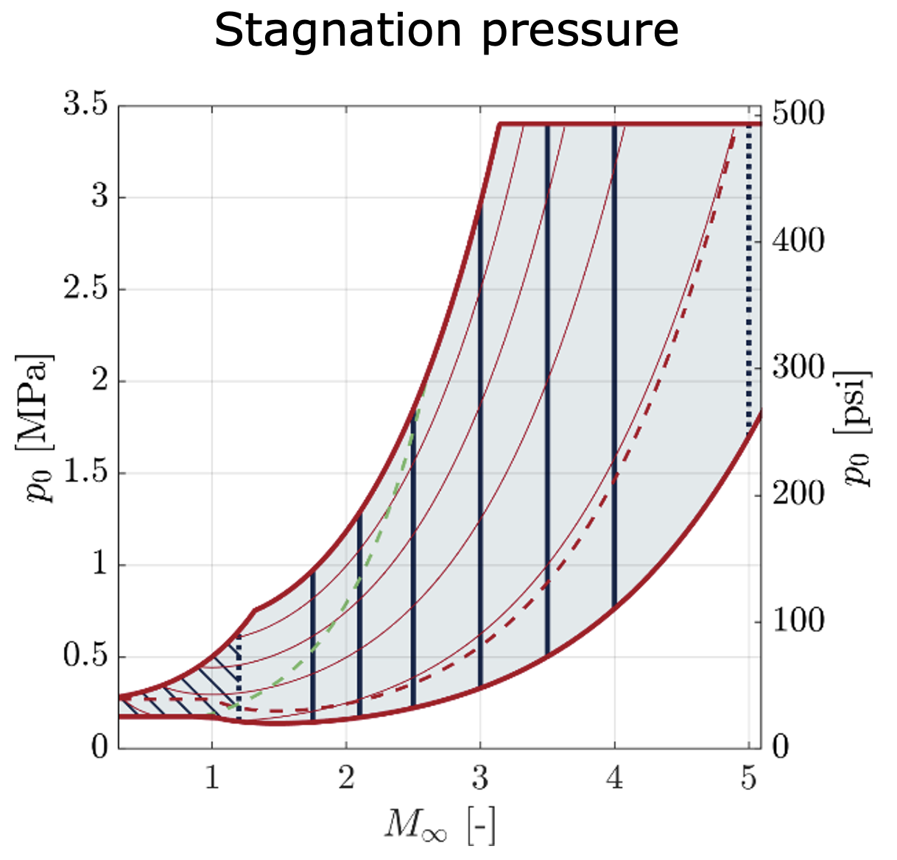
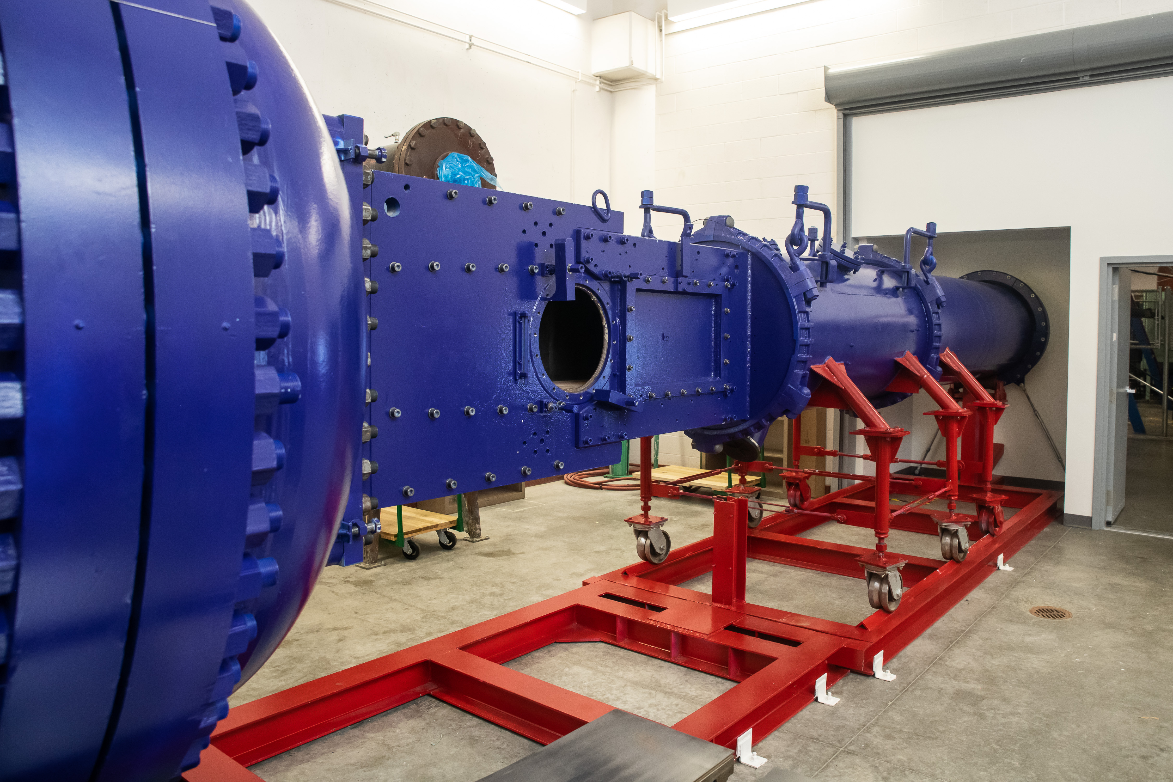
Arizona Polysonic Wind Tunnel
Blowdown Wind Tunnel located at the AME building at UArizona
Test Section: 15in x 15in x 50in
Current Mach Range: 1.7 - 4
Run Time: 10-25 seconds
The Arizona Polysonic Wind Tunnel
Notes:
Focus on understanding the effects of sweep, which requires full understanding of the unswept interaction as a baseline.

Slide 3
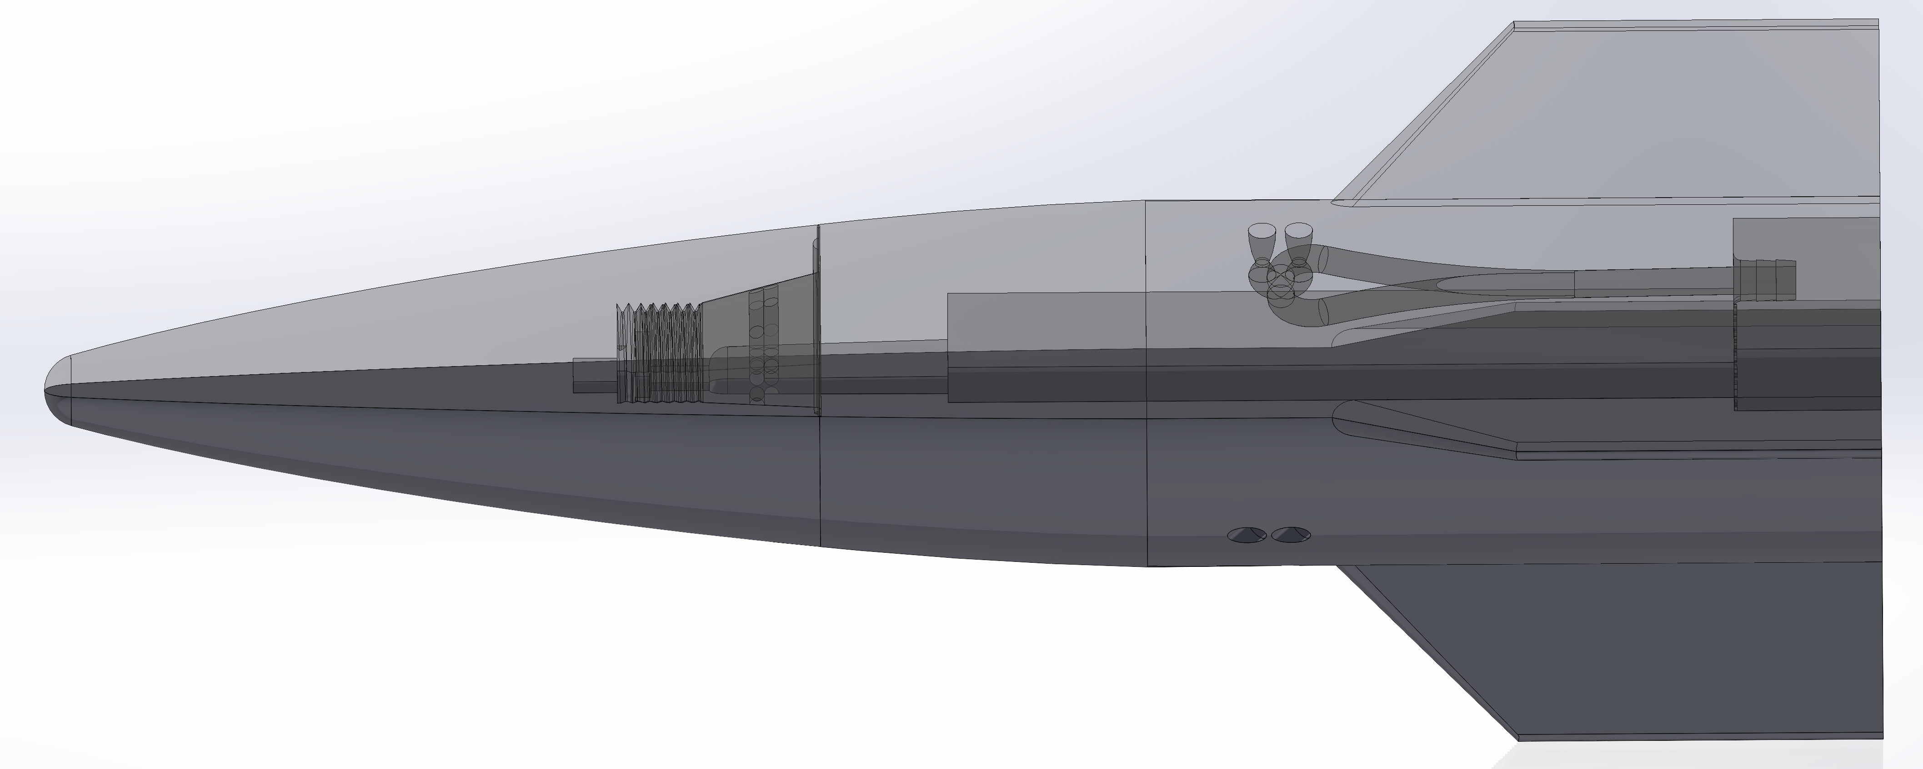
Project Overview / Motivation
Jets allow for increased control of aerodynamic vehicles
The goal is to test varying jets to increase understanding of flow behavior, thus expanding our knowledge of aerodynamic control.
Notes:
Focus on understanding the effects of sweep, which requires full understanding of the unswept interaction as a baseline.

Slide 4
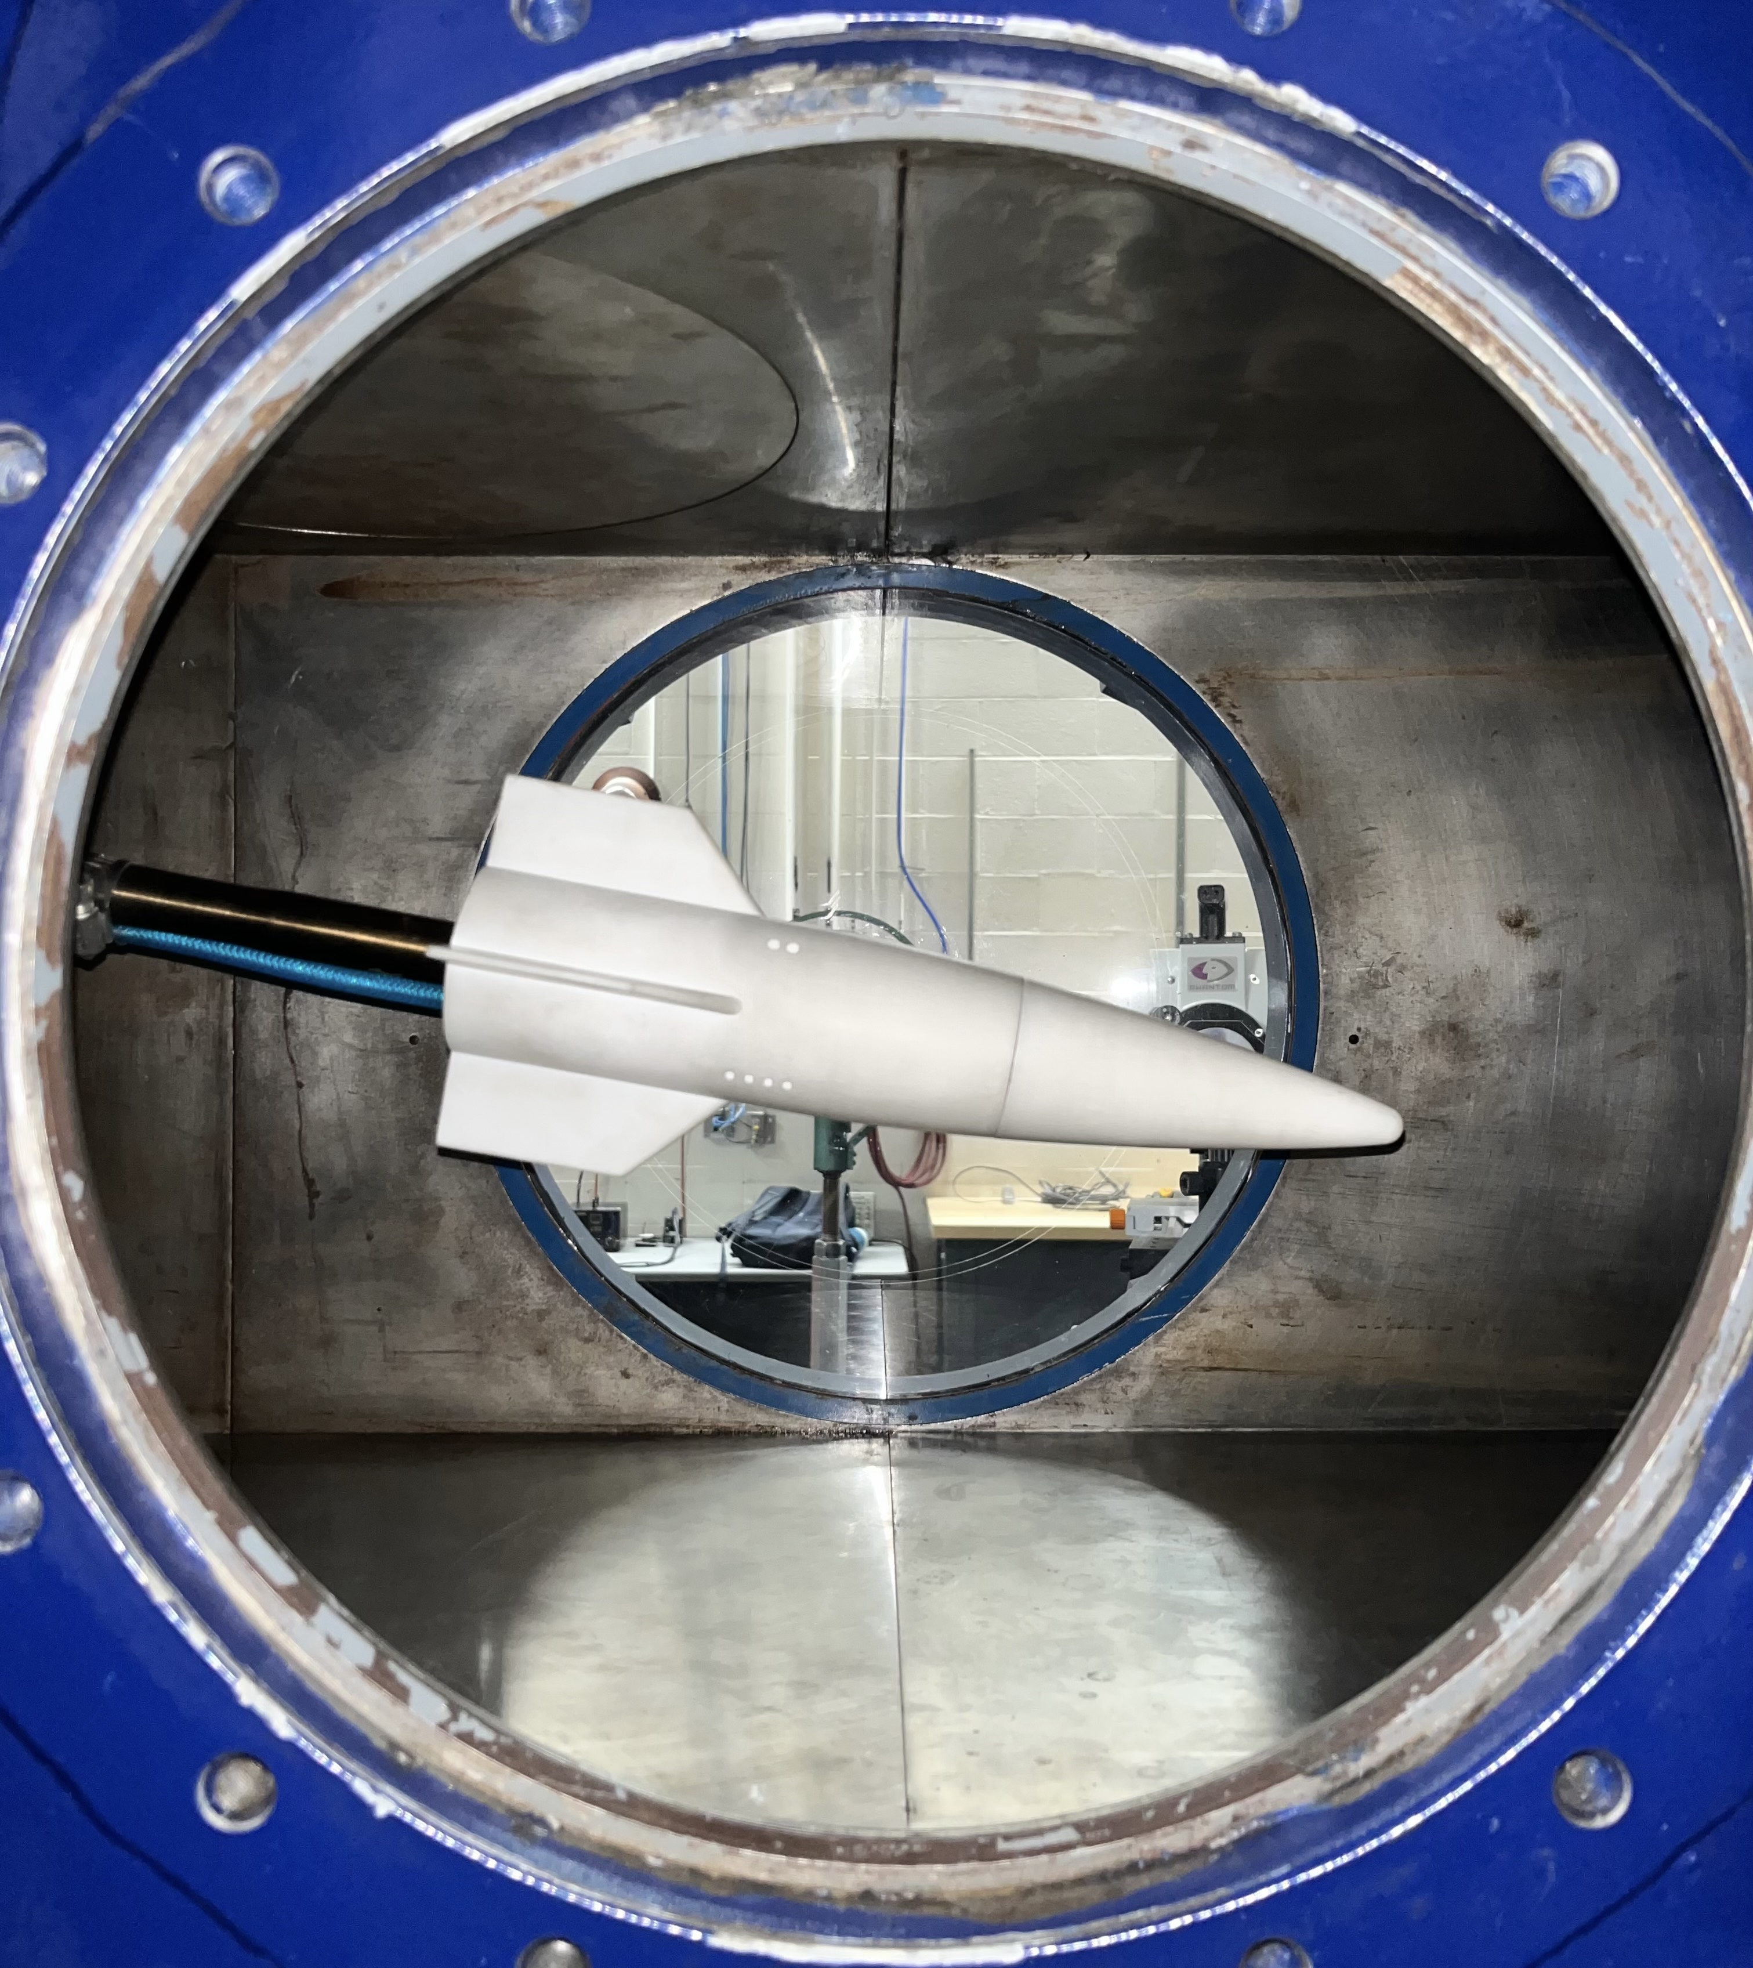
Jet/Model Design
Mass flow calculations helped determine proper tubing selection and nozzle design
Design Constraints
Jet Sizes
Tubing interface
Manufacturability
Structural Integrity
Notes:
Focus on understanding the effects of sweep, which requires full understanding of the unswept interaction as a baseline.

Slide 5
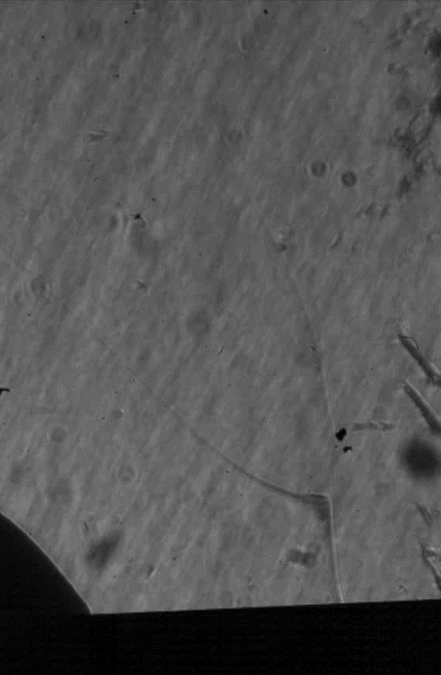
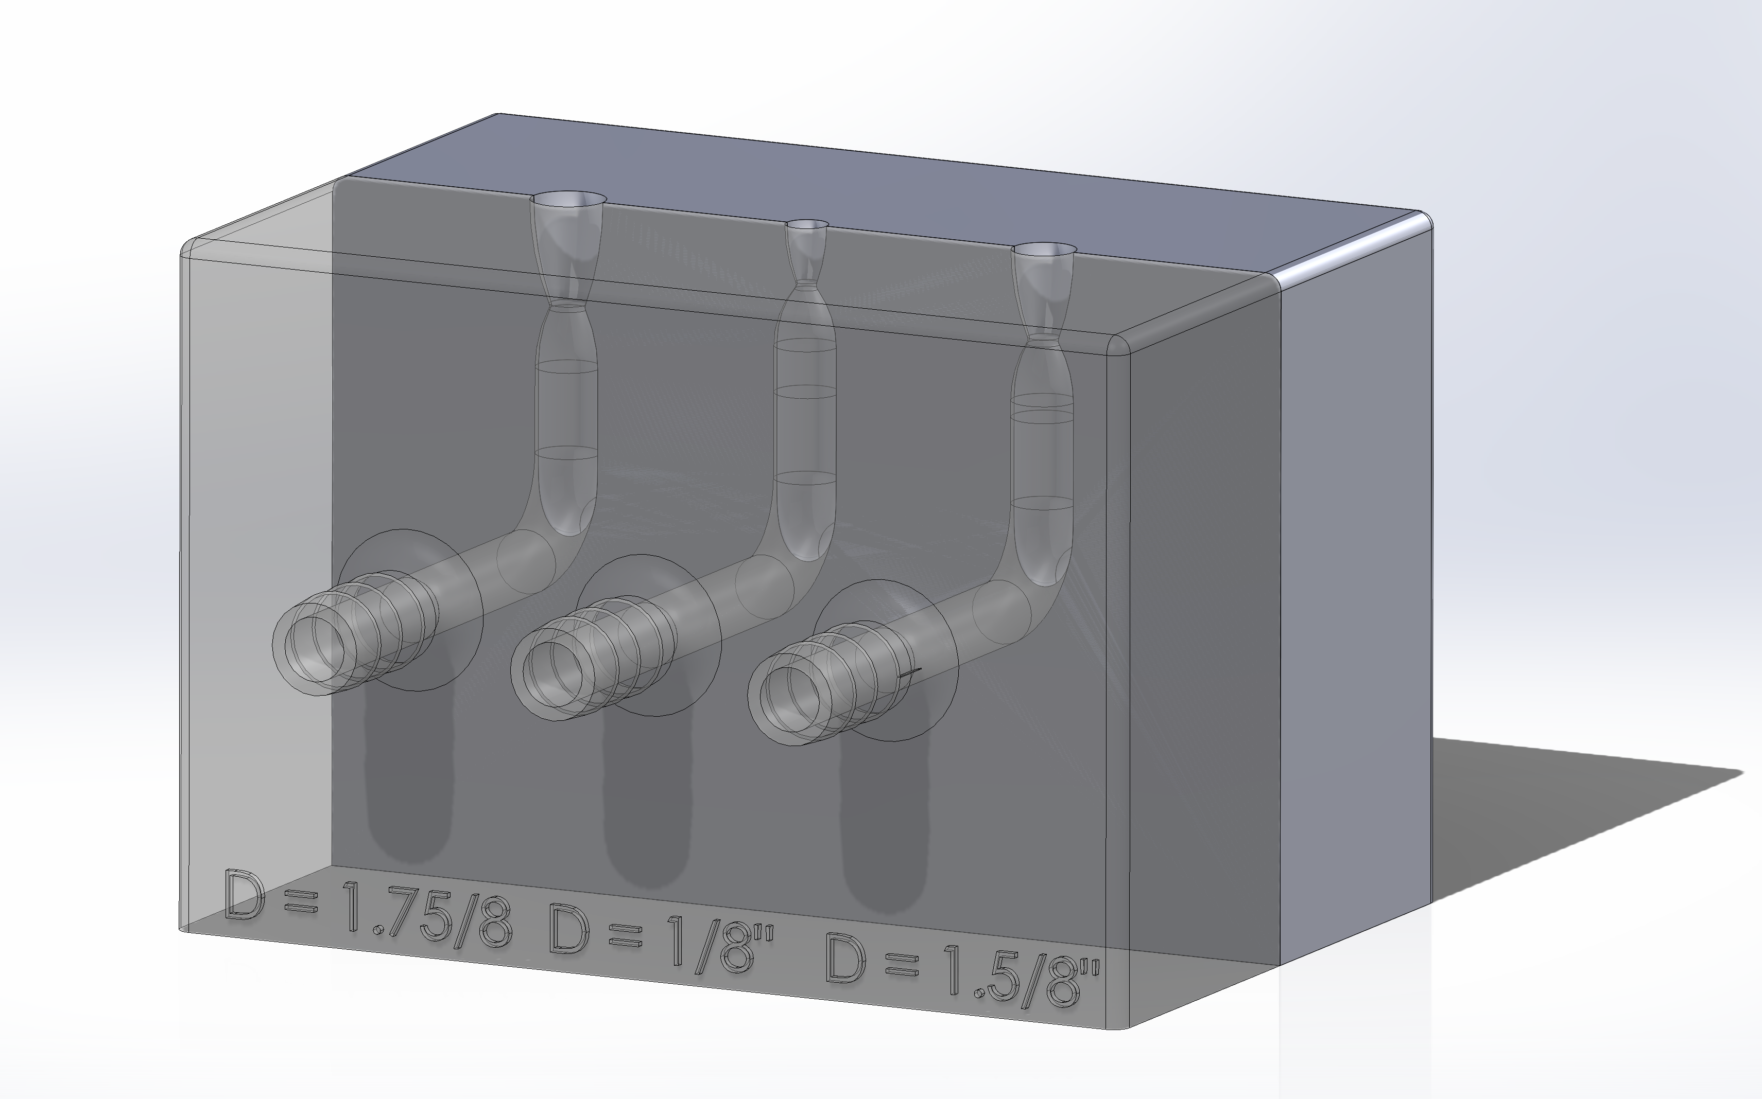
Velocity Profile Testing
Pressure transducer measurements were taken to test jet velocity.
Schlieren visualization was used to analyze the flow patterns surrounding the the jets, assuring a uniform flow profile at the jet exit.
Nozzle Block:
Notes:
Focus on understanding the effects of sweep, which requires full understanding of the unswept interaction as a baseline.

Slide 6
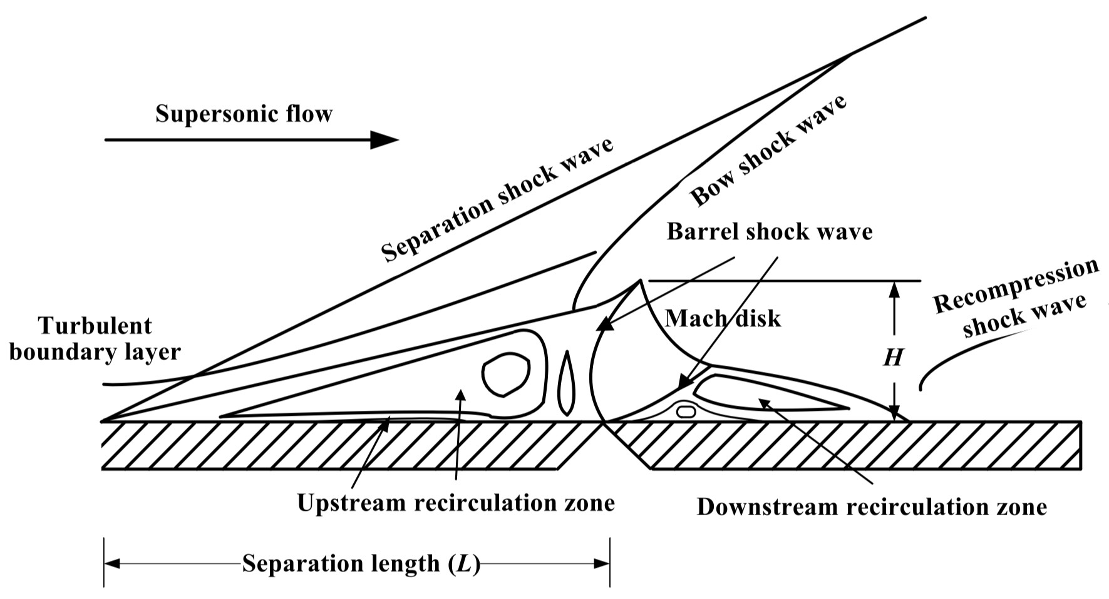
Transverse Jet in Supersonic Crossflow
Shock waves form due the freestream/jet interaction.
Separation takes place in the boundary layer.
A Prandtl–Meyer expansion fan forms, and the flow is compressed by the barrel shock wave and Mach disk.
A recompression shock wave occurs in the recirculation zone.
Notes:
Focus on understanding the effects of sweep, which requires full understanding of the unswept interaction as a baseline.

Slide 7
Future Work and Testing Plans
Further testing will provide insight into flow dynamics for optimizing pneumatic systems in supersonic environments, contributing to the advancement of aerospace technology.
Acknowledgments
UArizona-NASA Space Grant
University Consortium for Applied Hypersonics
Arizona Research Center for Hypersonics
RTX
Dr. James Threadgill
Dr. Ashish Singh
Dr. Jesse Little
Nicholas Mammana
Notes:
Focus on understanding the effects of sweep, which requires full understanding of the unswept interaction as a baseline.

Slide 8
Thank you!

